Slide 1
GroupProject.jar
Keylogger
By Matthew Austin & Sean Ulrich

Slide 2
Static Analysis (Process)
Downloaded ‘GroupProject.jar’ from server.
Opened ‘GroupProject.jar’ with JD-GUI program.
Instant Red Flag: Java Class "MyKeylogger", "NativeKeyListener", and two more .jar files "httpclient" and "jnativehook".
Read through the code, analyzed classes and package code.
Document findings.

Slide 3
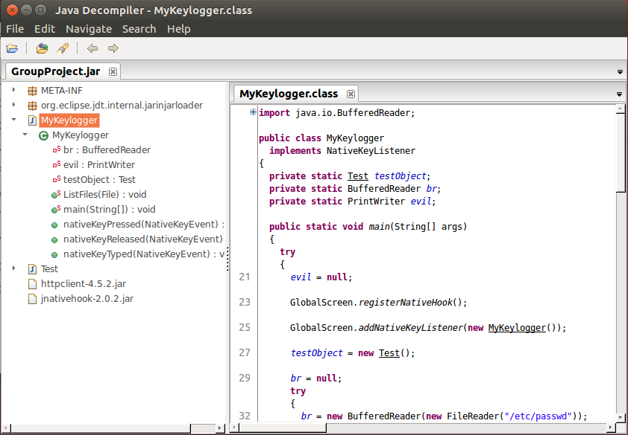
Obvious Malware
Upon opening GroupProject.jar the first class shown is named “MyKeylogger”.

Slide 4
Static Results/Affects
GroupProject.jar is blatantly a keylogger
Has class named “MyKeylogger”.
Sends data (keystrokes and file paths/names) to server primetech.
User Accounts and password hashes
Uses APIs that helps to allow the program to have internet connection as well as listen to mouse and keystrokes via httpclient.jar and jnativehook.jar.
Malicious, could be worse if server was reconfigured (prime tech).

Slide 5
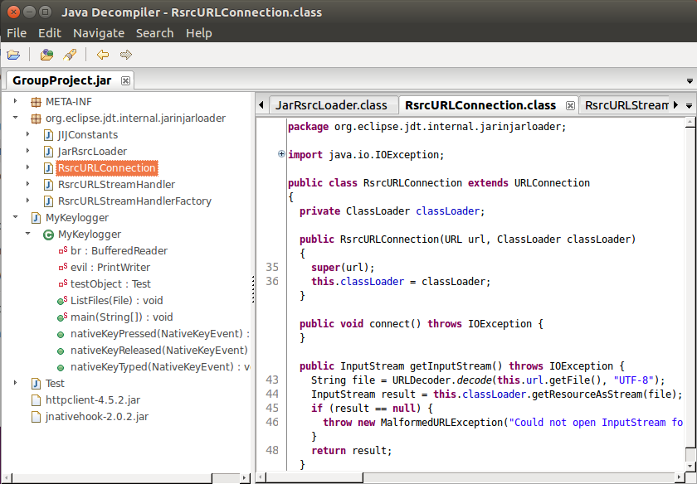
Internet Access & Run Exe (org.eclipse.jdt.internal.jarinjarloader)
Contains (Networking Classes):
JiJConstants
RsrcURLConnection
RsrcUrlStreamHandler
RsrcURLStreamHandlerFactory
Separate httpclient-4.5.2.jar resource that helps with internet access

Slide 6

MyKeylogger.class
Class contains
Variables:
‘br’ BufferReader
‘evil’ PrintWriter
‘testObject’ Test (an Object)
br and evil are used to:
Get user account and password/hash. (passwd & shadow)
Makes tmp file and sends information to Test (goes to server)
‘nativeKeyPressed’ prints keys pressed and sends key pressed to server via Test

Slide 7
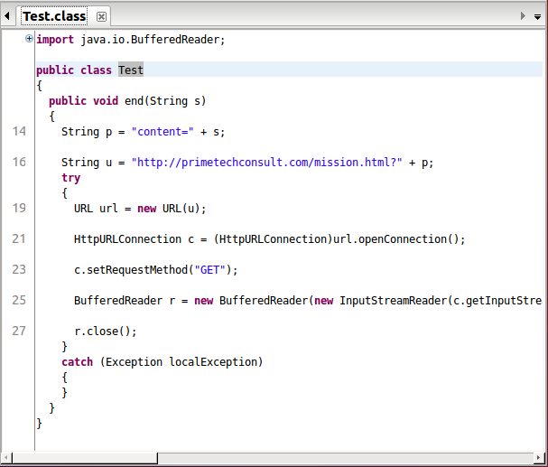
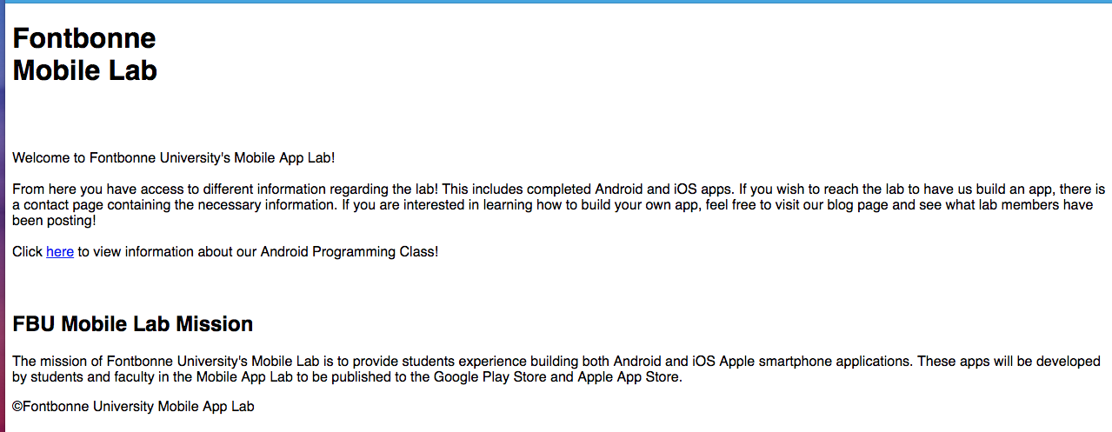
Test.class
The Test class sends data to the server url “http://primetechconsult.com/mission.html?content=”
Uses BufferReader, InputStreamReader, and HttpUrlConnection.

Slide 8
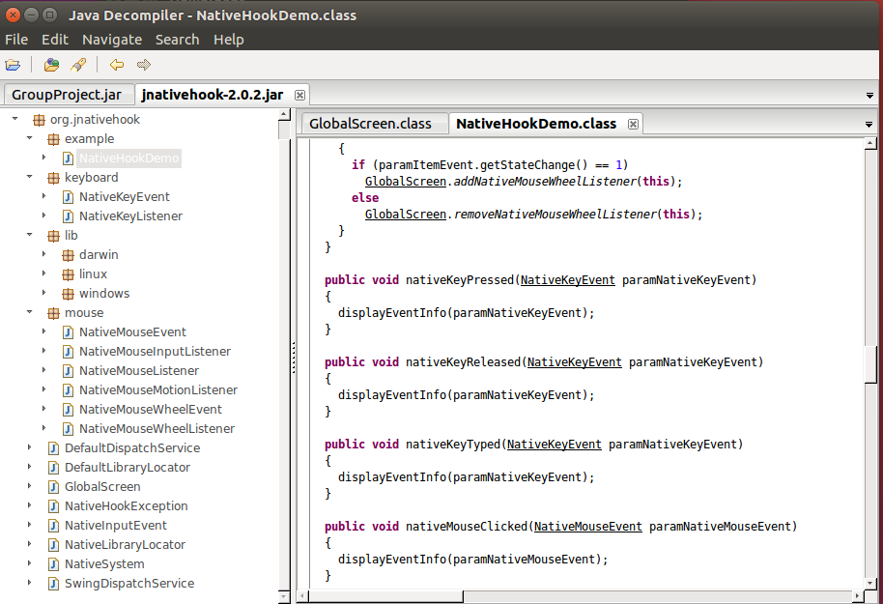
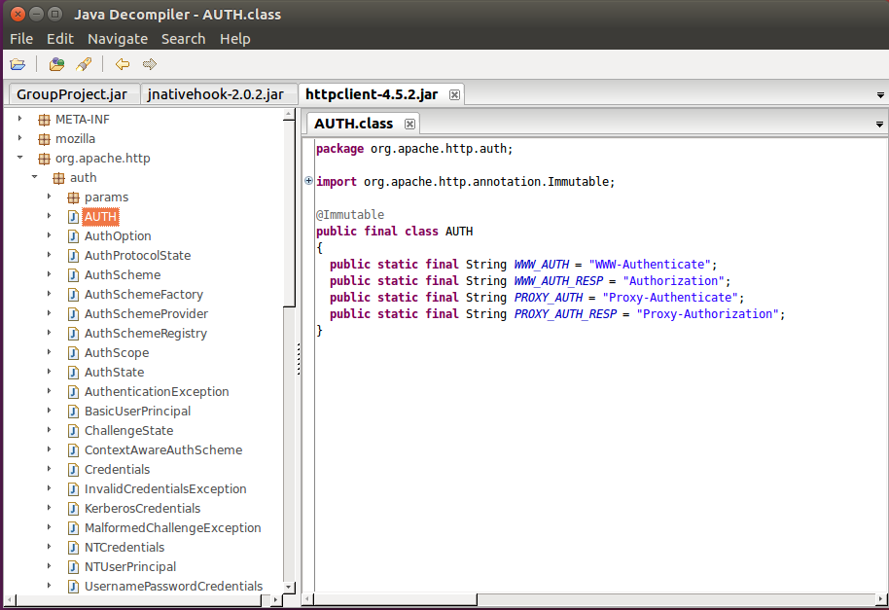
jnativehook-2.0.2.jar & httpclient-4.5.2.jar APIs
'httpclient.jar' which contained the resources for the program to connect to the internet.
'jnativehook.jar’ contained the resources for Global keyboard and mouse listeners for the malicious programmer to use.

Slide 9
Dynamic Analysis - Steps
Ensure essential programs are downloaded
Wireshark, bmon, iptraf
Record original system state
Primarily network state
Download file
Execute file while recording changes in system state
Observe Behavior and Data
Record findings and observations

Slide 10
Programs Used
Wireshark
packet information, network traffic, IP and ports, protocols used
Bmon
network traffic confirmation
iptraf
Network traffic confirmation, port and protocol information

Slide 11
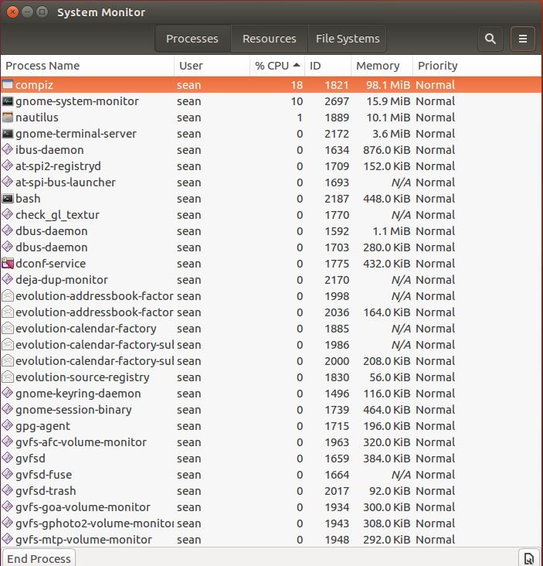
Original System State
No network traffic, at all
Minimal CPU usage
Imagine an empty Wireshark
packet capture

Slide 12
Running Results/Affects
Blatantly announced it was a keylogger and mouse hook
However, couldn’t find evidence of the latter from the dynamic analysis
75312 packets were sent in 286 seconds(4.7 min)
From host VM to 107.180.57.91
75312 / 286 = rough average of 263 packets per second
This includes user activity, like pushing keys

Slide 13
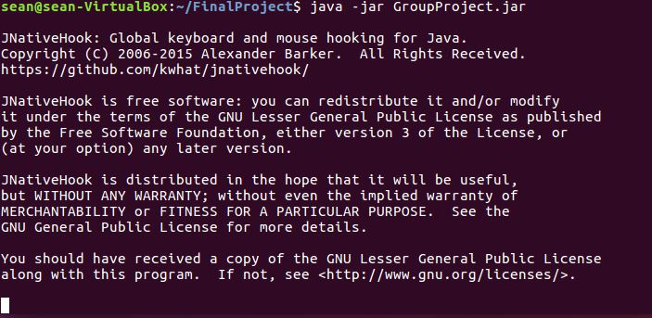
The Blatant Announcement

Slide 14
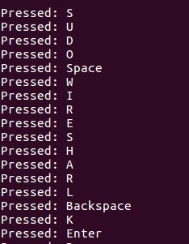
The Blatant Evidence
Repeated keys typed into the console
(Lesson learned, separate console needed to launch Wireshark with admin privileges)

Slide 15
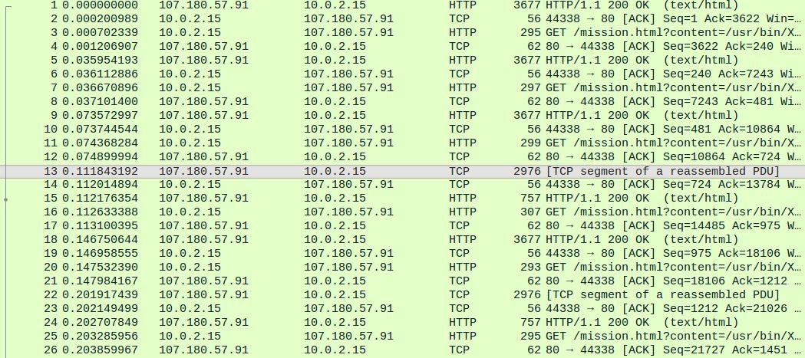
Wireshark
From silent to dominated by packets similar to as shown

Slide 16
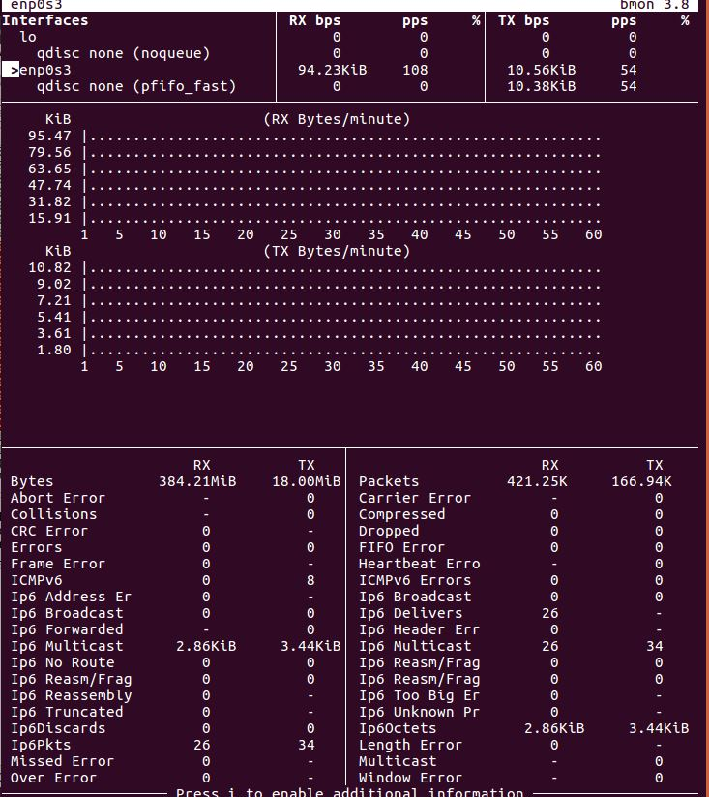
Bmon Statistics Example
RX – receive rate
TX – transmit rate
About a minute before killing the jar file

Slide 17
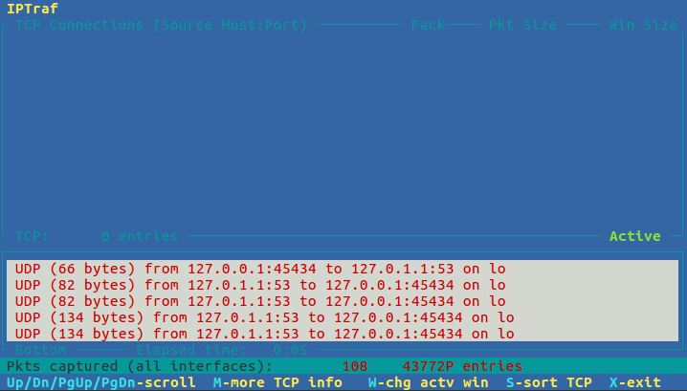
Iptraf Example
What initially brought attention to DNS and ports
Port 53 – DNS usage
Others are large, unusual, and designated for TCP/UDP
Notes:
Note: 127.0.0.1 is what DNS would project to the internet

Slide 18
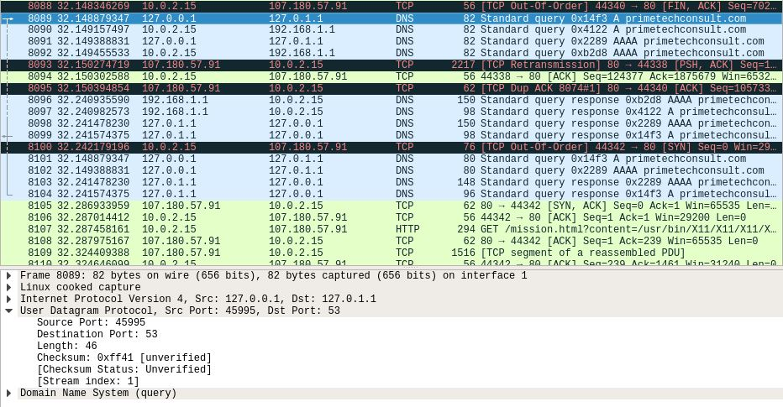
Wireshark DNS

Slide 19
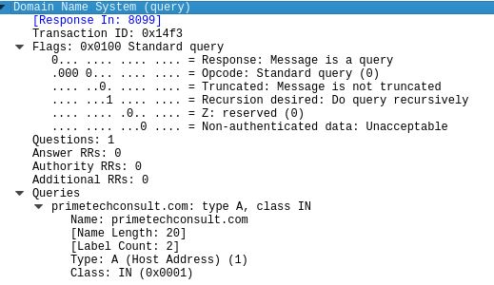
Wireshark DNS

Slide 20
Wireshark Sending & Reconnections
Had trouble finding specific keyboard characters being sent
Clumped together connection resets suggest rough time of keystroke
Connection reset after keystroke is recorded and sent to server via TCP connection

Slide 21
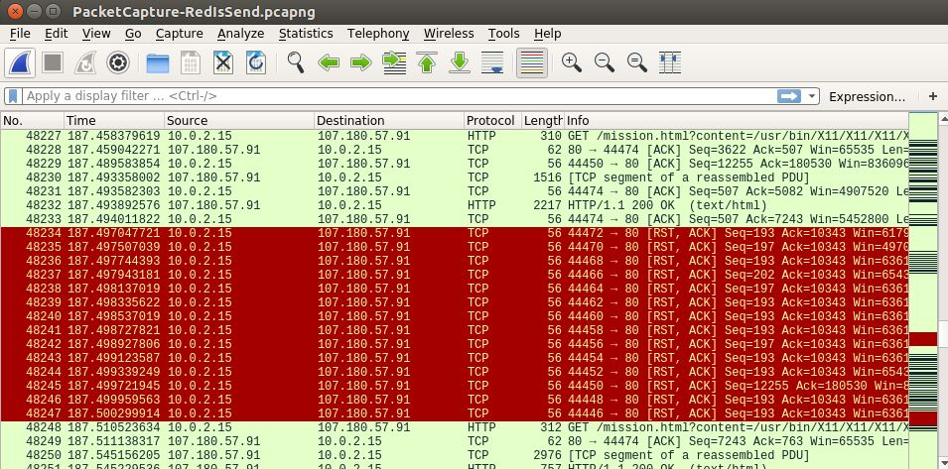
Wireshark Reconnections
These moments, highlighted in red, were rare
Blocks or single packets

Slide 22
Demo

